Slide 1
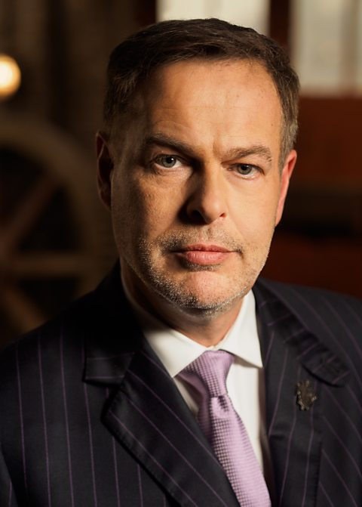
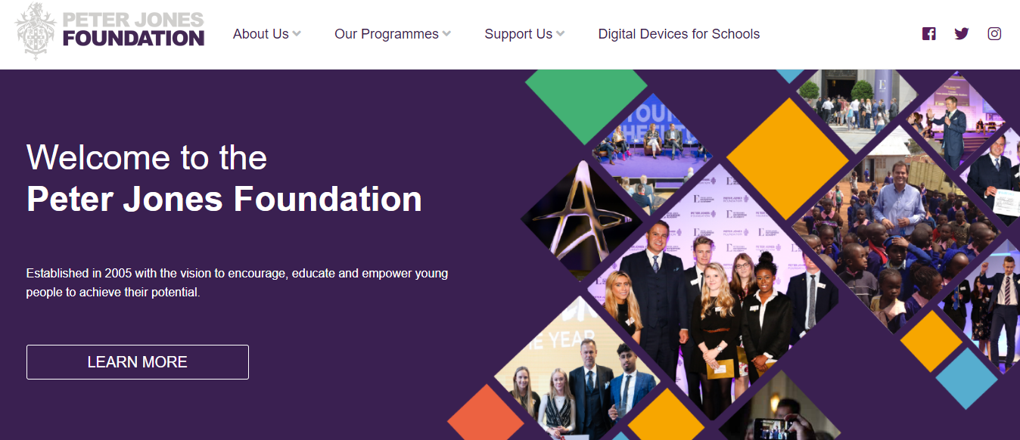
Peter Jones Foundation
Would you like to run your own business?
You have the opportunity to create a business plan based on a business idea of your choice sustainability and creativity
As a group you will run the business and trade
You could also have the opportunity to present your business plan to Peter Jones
Your group will receive funding for your business
As a group you get to keep profits from business
There will be opportunities for your group to gain enterprise experience through our Enterprise day – Christmas
Lunch time club – BTEC/ GCSE - Thursday in Room 13 with Miss Long and Mr Mahmood
Enterprise club will start 23/9/21
Would you like raise some money?
Would you like to be part of a successful team running a business?
Notes:
Timetable put in place

