Slide 2
Our internet, our choice
Understanding consent in a digital world

Slide 3
What is big data?
Data is information about us and we are creating it all the time online and offline. It can include:
what we do,
where we go,
sites we visit,
comments we make,
photos we take,
accounts we create.
Big data is extremely large sets of data collected by organisations in order to be analysed to reveal patterns, trends, and associations, especially relating to human behaviour and interactions.

Slide 4
Every minute we create new data…
Twitter users send 456,000 tweets
Google conducts 3,607,080 searches for us
Snapchat users share 527,760 photos
Wikipedia users publish 600 new page edits
Instagram users post 46,740 photos
Notes:
https://www.domo.com/learn/data-never-sleeps-5

Slide 5
Can you guess the answer?
We have collectively created more data about ourselves in the last ___ years than in our entire history of civilisation beforehand.
2
Notes:
https://www.domo.com/learn/data-never-sleeps-5

Slide 6
Worldwide every minute….
Are there more
or
texts sent?
emails sent?
EMAILS SENT WINS!
159 Million
12 Million
Notes:
https://www.domo.com/learn/data-never-sleeps-5

Slide 7
Worldwide every minute….
Are there more
or
Google searches
videos watched on YouTube?
YOUTUBE WINS!
4.3 Million
3.9 Million
Notes:
https://www.domo.com/learn/data-never-sleeps-5

Slide 8
Worldwide every minute….
Is there more
or
more money left in our shopping baskets?
actually spent?
SPENT WINS!
$10.8 Million (£8.3 Million)
$7.6 Million (£5.8 Million)
Notes:
https://www.domo.com/learn/data-never-sleeps-5

Slide 9
Worldwide every minute….
Are there more
or
snaps sent?
tweets posted?
SNAPCHAT WINS!
2 Million
473,000
Notes:
https://www.domo.com/learn/data-never-sleeps-5

Slide 10
Are you happy with your data being stored by companies?
Notes:
https://www.domo.com/learn/data-never-sleeps-5

Slide 11
A choice many of us make or have already made….?
There is a saying that if you get something for free, you should know that you're the product….You get free social-media services, and you get free funny cat videos. In exchange, you give up the most valuable asset you have, which is your personal data.
Professor Yuval Noah Harari,
Author and Historian

Slide 12
We’re the product -
but what does that mean?
You get to use cutting edge technology for free
You give sites you visit and apps you use data about what you do, what you like, the things you buy etc.
Advertisers pay to sell you things online
These sites and apps use the information to improve their sites
They might sell on your information to other sites and services
Is it a win-win? Or time to bin?

Slide 13
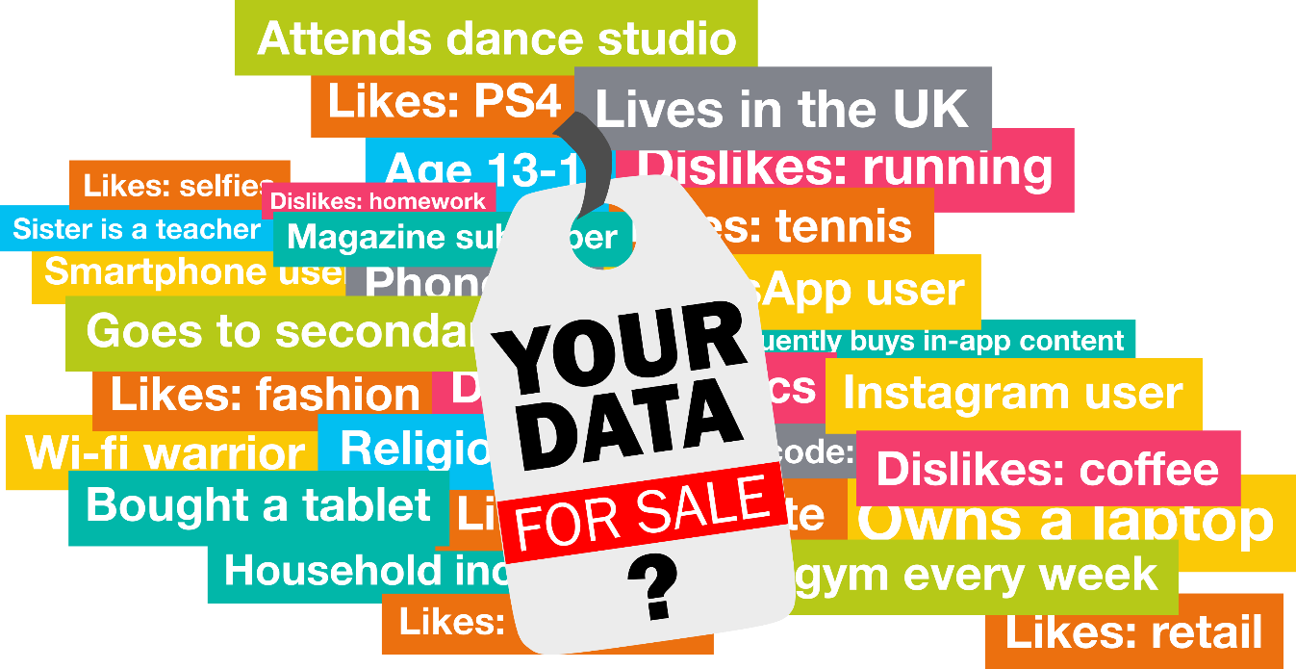
So who has all this data?
We are creating data all the time so lots of companies will have some kind of data about us.
Does it matter?
What are people doing about this?

Slide 14
What does Google know about us?
Everything we search for
Every website we visit on Chrome
Any emails we send via Gmail
Everywhere we go using Google Maps
Anything we watch on YouTube
The devices we use and how we use them if signed in to a Google account
Google owns over 200 companies and has invested in over 400 others
How could that information be used?

Slide 15
Think about your own ‘Digital Footprint’!

Slide 16
Tutorial Worship- watch and discuss the key messages from the videos
https://d1afx9quaogywf.cloudfront.net/sites/default/files/Safer%20Internet%20Day%202019/SID2019%20Top%20Tip%20Video%201%20for%2014-18%20year%20olds.mp4
https://d1afx9quaogywf.cloudfront.net/sites/default/files/Safer%20Internet%20Day%202019/SID2019%20Top%20Tip%20Video%202%20for%2014-18%20year%20olds.mp4
https://d1afx9quaogywf.cloudfront.net/sites/default/files/Safer%20Internet%20Day%202019/SID2019%20Top%20Tip%20Video%203%20for%2014-18%20year%20olds.mp4
https://d1afx9quaogywf.cloudfront.net/sites/default/files/Safer%20Internet%20Day%202019/SID2019%20Top%20Tip%20Video%204%20for%2014-18%20year%20olds.mp4
https://d1afx9quaogywf.cloudfront.net/sites/default/files/Safer%20Internet%20Day%202019/SID2019%20Top%20Tip%20Video%205%20for%2014-18%20year%20olds.mp4

