Slide 1
Current Affairs
W/C 19/11/2018

Slide 2
California Wildfires
The Camp Fire in northern California has killed at least 71 people.
More than 1,000 people are reported to be missing, although officials say that figure could fluctuate.

Slide 3
The following pictures and quotes are real… not from a film!

Slide 4
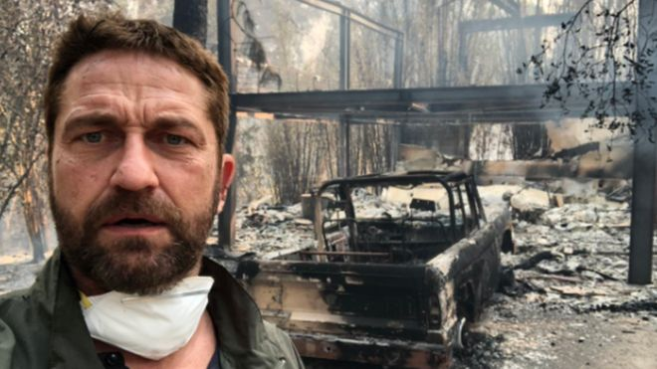
He said: "Heartbreaking time. Inspired as ever by the courage, spirit and sacrifice of firefighters."
Gerrard Butler’s burnt out home in Malibu

Slide 5
The Day Paradise Burned Down
"Fire was coming on both sides. It was a fire tornado," she later tells CBS. "All of a sudden, it filled with black smoke."

Slide 6
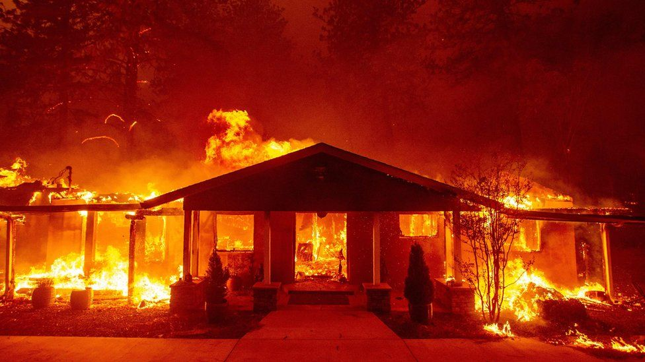
The Day Paradise Burned Down
Over the radio, they hear that one of the ambulances ahead of them has caught fire. They pull over and realise they can't make it any further, and hear the small blasts of transformers exploding around them.

Slide 7
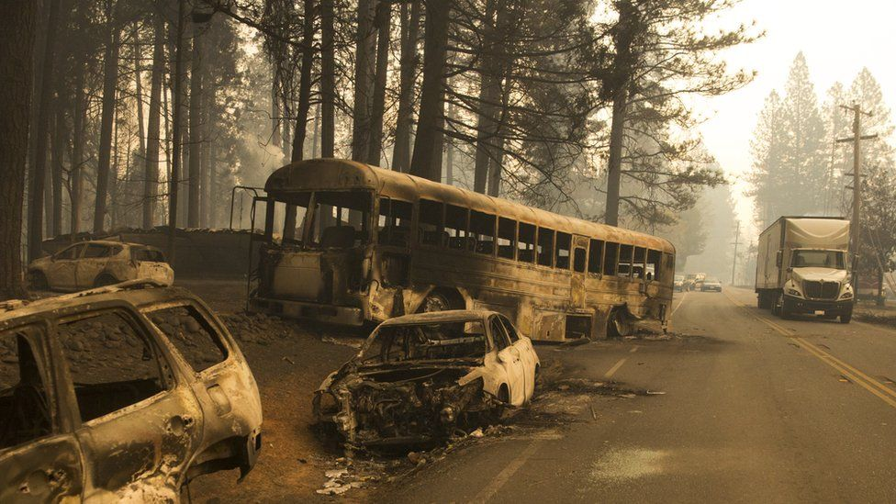
"I looked out the back window at the devastation, while I conversed with the sweetest 95-year-old woman," Tamara later says. "We watched the flames beside us, burnt cars in the road, power lines down and fresh homes burning. It went on for miles
"I honestly couldn't believe I was alive, that I would see my family, kids and boyfriend again."

Slide 8
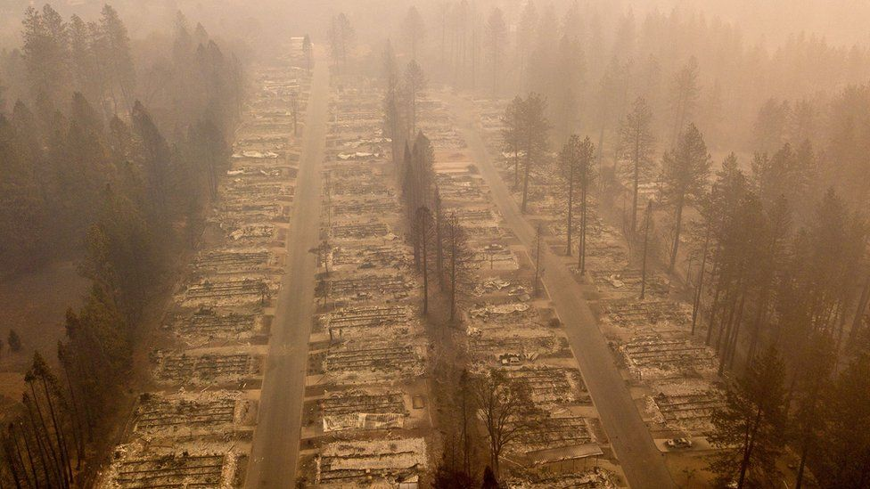
Imagine these were the houses on your street.
So far, the Camp Fire has destroyed more than 12,000 properties and 142,000 acres. Ten days on, it continues to burn and it is unlikely to be fully contained until the end of the month.

Slide 9
HOW HOT!?- Melted metal from abandoned cars

Slide 10
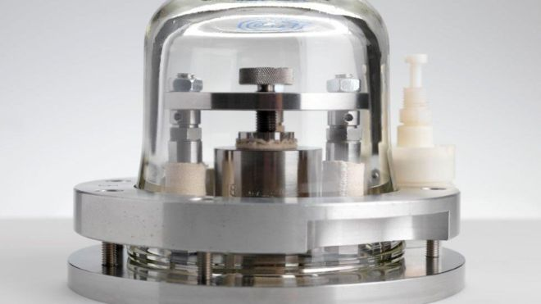
Scientists have changed the way the kilogram is defined.
Currently, it is defined by the weight of a platinum-based ingot called "Le Grand K" which is locked away in a safe in Paris.
Last week, researchers meeting in Versailles voted to get rid of it in favour of defining a kilogram in terms of an electric current.

Slide 11
Le Grand K has been at the forefront of the international system of measuring weights since 1889. Several close replicas were made and distributed around the globe.
But the master kilogram and its copies were seen to change - ever so slightly - as they deteriorated.
In a world where accurate measurement is now critical in many areas, such as in drug development, nanotechnology and precision engineering.
The fluctuation is about 50 parts in a billion, less than the weight of a single eyelash. But although it is tiny, the change can have important consequences.

Slide 12
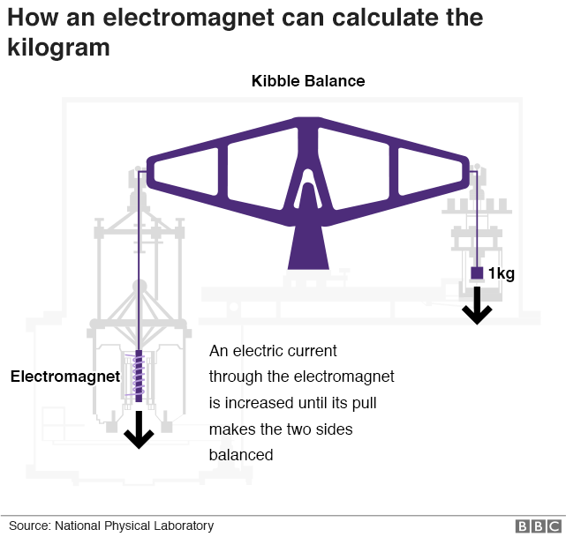
So what will they use now…
Confused….?
Ask your Science Teacher!

Slide 13
It would take more than a few minutes in an assembly to explain… However….
More

Slide 14
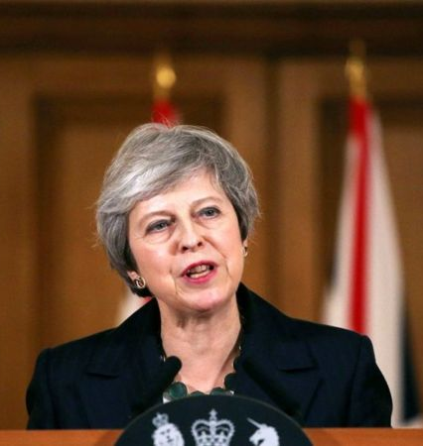
The prime minister says she believes in her Brexit plan and insists she'll carry on doing her job.
In a dramatic press conference, Theresa May told reporters she was committed to seeing the process through and believed that her plan was the best one.
After months of talks, the prime minister had earlier announced a deal for Britain to leave the European Union (EU) - a move known as Brexit.
On Wednesday 14 November, she had a five-hour meeting with her cabinet - a group of her top ministers. Although they all agreed on the deal at the time, some of them weren't very happy about it and have since left the top team because they felt they couldn't support it.

Slide 15
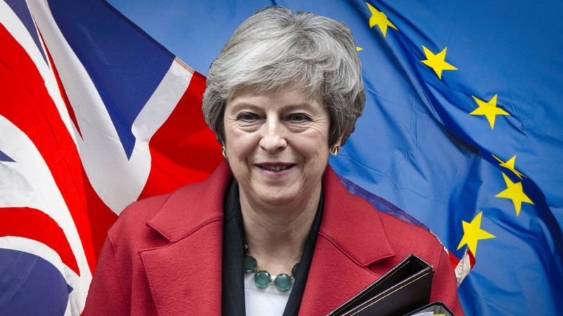
There have been lots of arguments about her plan, about what should happen next and even about Theresa May's future as Prime Minister - with some of her own MPs calling for her to resign.
There are lots of issues that need to be decided on for Brexit to happen. For example, what will happen to the border between Northern Ireland (in the UK) and the Republic Ireland (which will remain in the EU), and how the UK will buy and sell goods with EU countries.

Slide 16
BBC CHILDREN IN NEED.
Children in Need has now raised over £1 billion since it began the annual fundraiser in 1980.
It comes after a record-breaking £50.6 million was donated during Friday's programme.
The five-hour show saw the cast of EastEnders dress up as Disney characters and perform a medley.

Slide 17
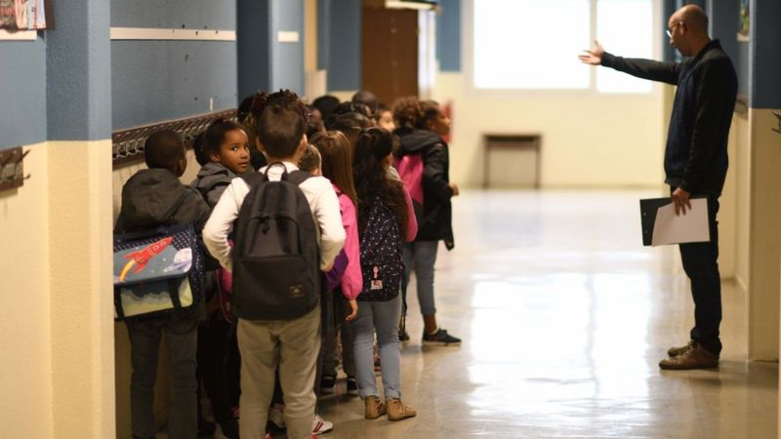
Would you be able to keep quiet in the school corridor?
What do you think about staying totally quiet in the corridor between your lessons?
Well, parents of pupils at a secondary school in Birmingham say they were sent a letter earlier this month saying their children would be expected to move around the building in silence.
In the letter, the school's acting co-heads said the policy would mean children arrived 'calmly and ready to learn because good behaviour needed to be maintained throughout the day.'
The letter to parents said students will be expected to be completely quiet as they move from assembly and when moving from lesson to lesson.
Children will be able to talk in the canteen at lunch and on the field at break times.
If pupils break the rules, they'll get a 20-minute detention.
Some parents and students aren't happy with the idea, saying it's too strict.
But this isn't the first school to bring in the silent guidelines. With some claiming it can improve behaviour and results.

Slide 18
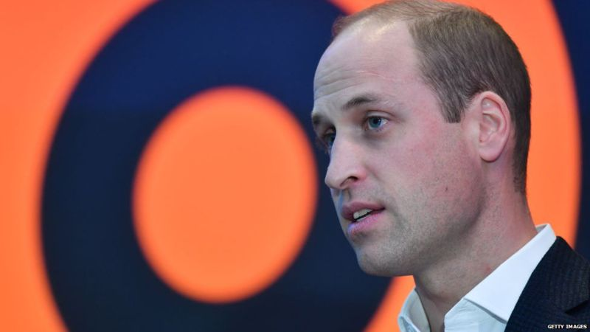
“Our technology companies still have a great deal to learn about the responsibilities that come with their significant power.”
HRH Duke of Cambridge
Studies suggest that some 35% of 11-17 year olds have experienced some form of cyberbullying during their lives, and 40% have witnessed cyberbullying online.
In response to this issue, the prince launched a taskforce in 2016 to raise awareness and offer practical support for children and young people suffering cyberbullying.

Slide 19
Jermain Defoe has dedicated his OBE to his young friend Bradley Lowery, who passed away from a rare type of cancer last year.
Defoe, who was honoured at Buckingham Palace this morning for services to his foundation, formed a strong bond with Bradley while playing for Sunderland, with the little boy repeatedly picked to be a mascot for his beloved club while he battled neuroblastoma.

